Slide 1
How convolution works? From a programmer perspective
Concepts, Mechanisms, Parameters, Structure, Behavior
with
Practical Examples

Slide 2
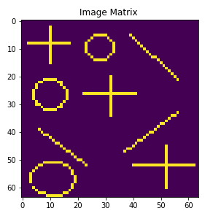
An Image Detection Project: Assume that an image like below is given

Slide 3
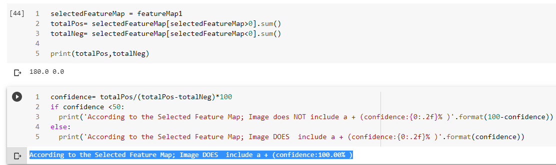
Decide whether the plus (+) shape exist in the image
We will develop an algorithm to detect the “+” shape in the given image with a confidence value

Slide 4
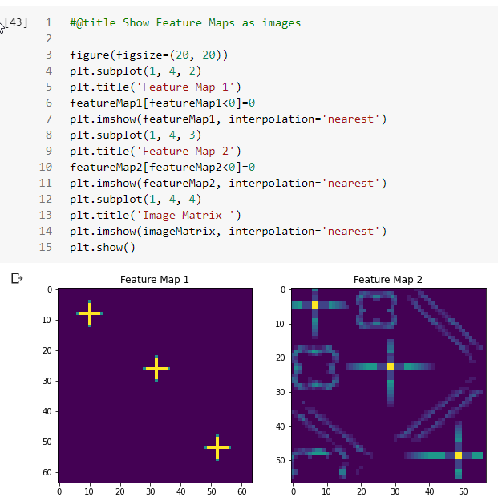
If exists, locate the shape in the given image

Slide 5
Project has 3 parts:
Part A:
Discuss Matrix Multiplication methods
Review Image File structure
Prepare a simple image dataset
Create a filter (kernel) for “+” shape

Slide 6
Project has 3 parts:
Part B:
Convolution as Element-Wise Matrix Multiplication & Summation
Apply Convolution to the given Image with “+” Filter
Calculate a probability score for existing “+” shape in the image
Test the algorithm with different images

Slide 7
Project has 3 parts:
Part C:
Apply Convolution onto an image with a larger size than the filter
Understand stride & padding
Formalize all these processes
Investigate Keras Conv2D layer
Integrate all we learn with Keras Conv2D layer

Slide 8
What to cover?
We will code with Python the 2D Convolution step by step:
Element-wise Matrix Multiplication
Image format: size, channels
Image processing: transpose, normalize, etc.
Convolution via Element-wise Matrix Multiplication
Stride & Padding
Filters (Kernels)
Weights
Feature Map

Slide 9
What to cover?
Finally: You will be able to easily recognize Keras Conv2D layer:
How it works?
What are the important parameters and their meanings?
How to set up?
What to expect as the output?
Conv2D layer will be no longer a mystery for you ☺

Slide 10
PART A: BACKGROUND

Slide 11
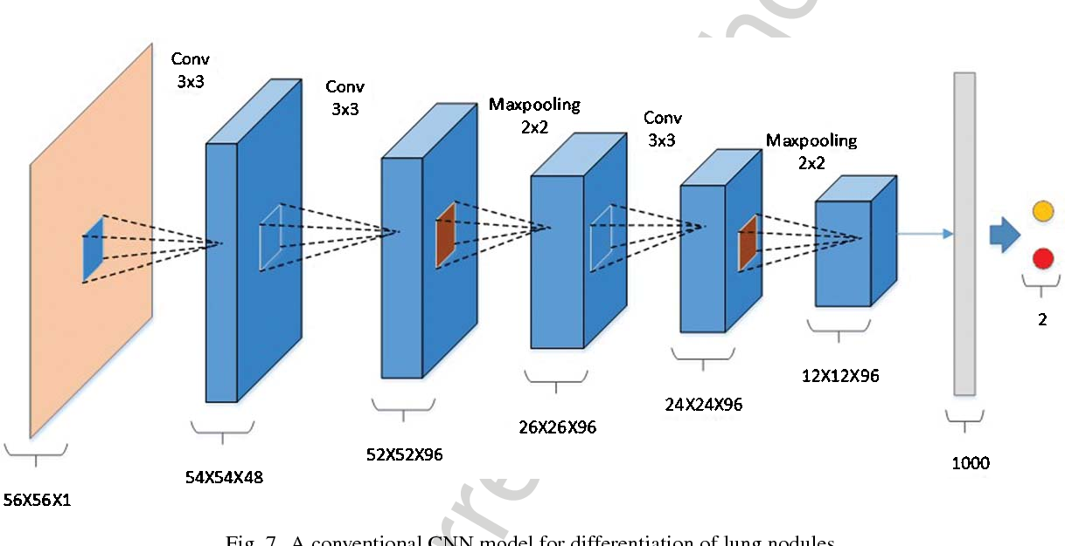
Generic CNN Architecture

Slide 12
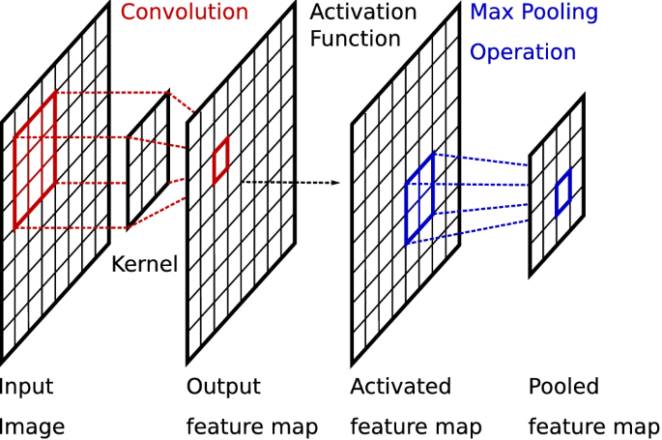
CNN Block: Convolution+Activation+Pooling

Slide 13
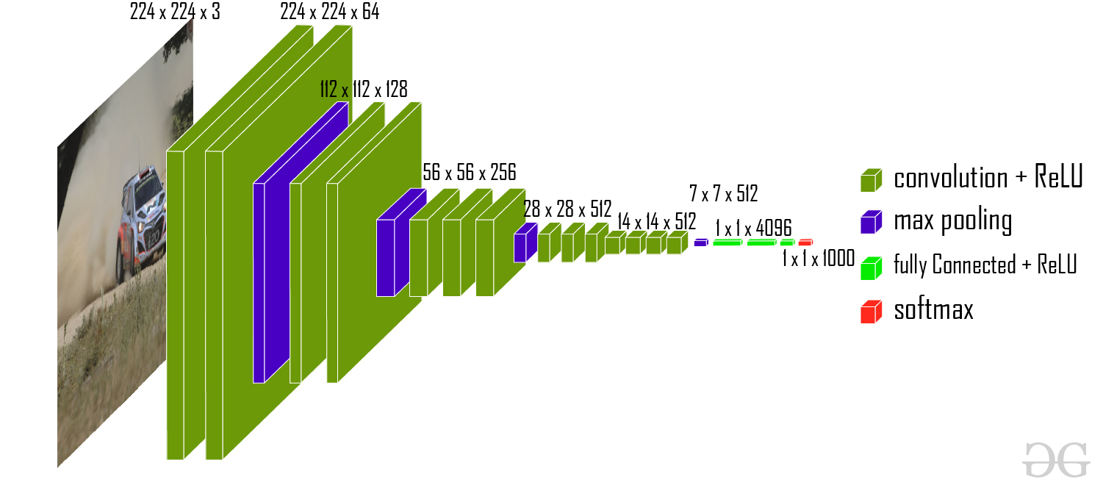
VGG16 CNN Architecture

Slide 14
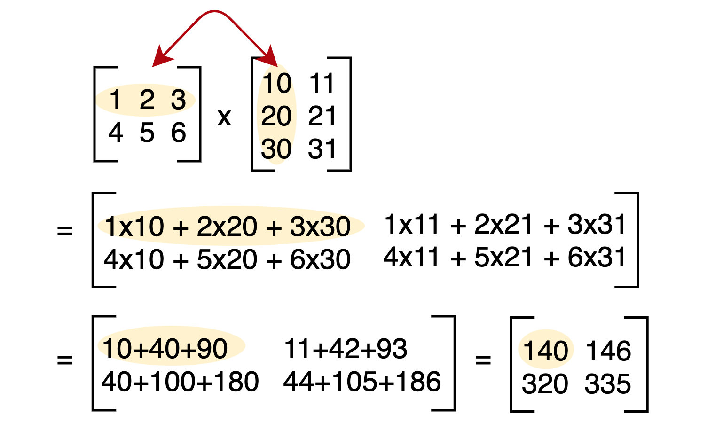
Matrix Multiplication
First, Let’s begin with Matrix Multiplication: In this context, we can argue that there are 2 types of matrix multiplication
The first one what we can remember from Linear Math as below:

Slide 15
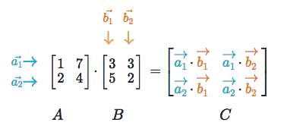
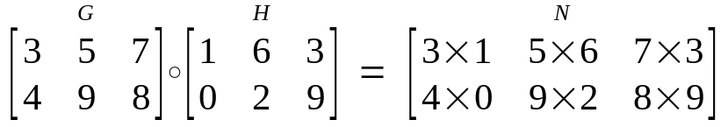
Matrix Multiplication
First, Let’s begin with Matrix Multiplication: In this context, we can argue that there are 2 types of matrix multiplication
The first one what we can remember from Linear Math
The second one is Element-wise Matrix Multiplication as follows:

Slide 16
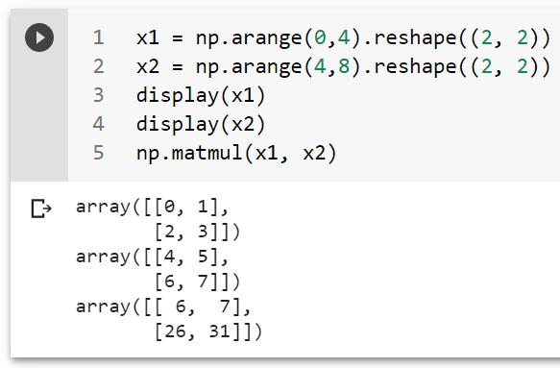
Matrix Multiplication with Numpy
The first one what we can remember from Linear Math as below:

Slide 17
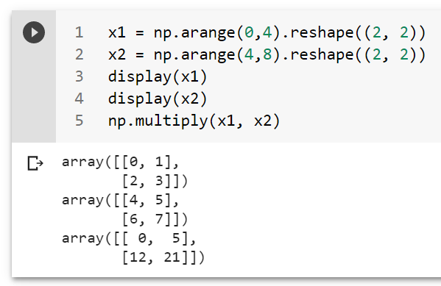
Matrix Multiplication with Numpy
The second one is Element-wise Matrix Multiplication as follows:

Slide 18
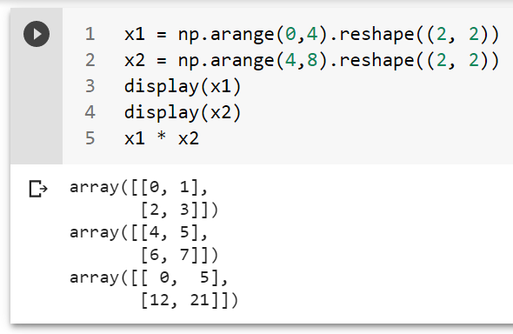
Matrix Multiplication with Numpy
The second one is Element-wise Matrix Multiplication as follows with * operator:

Slide 19
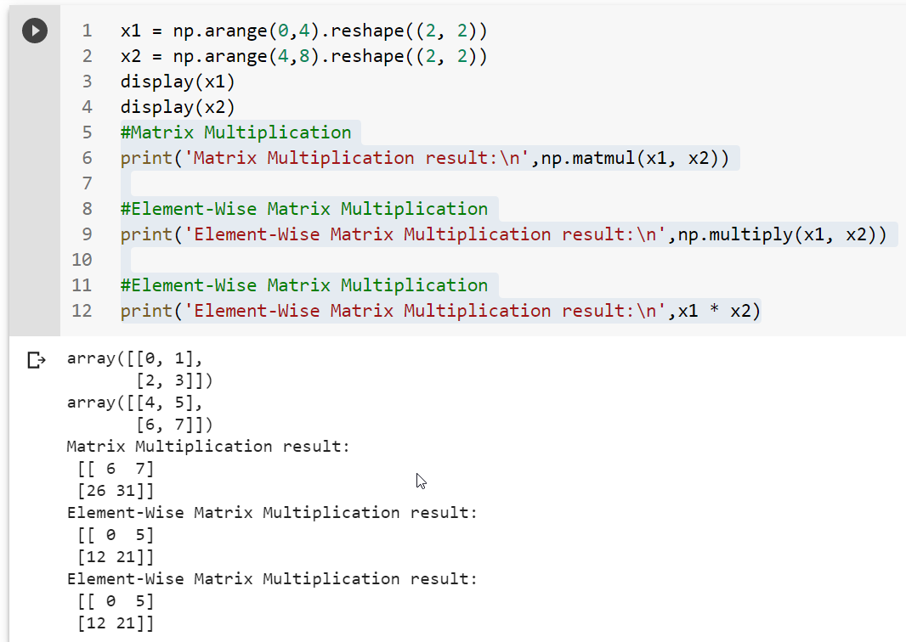

Slide 20
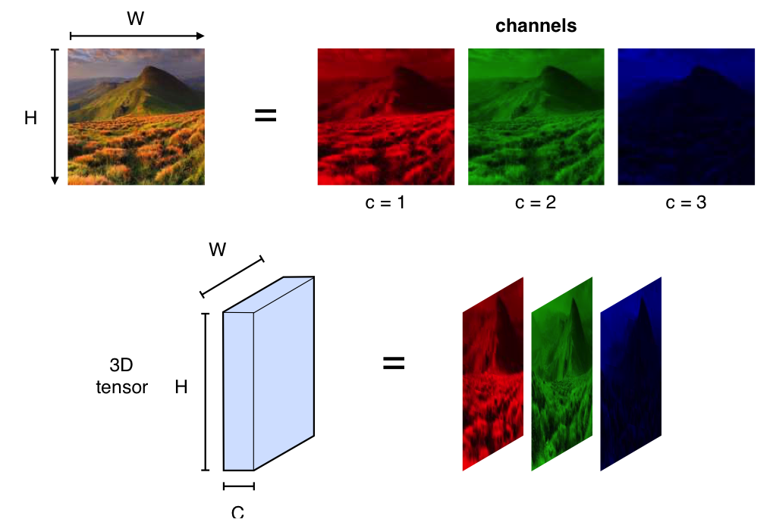
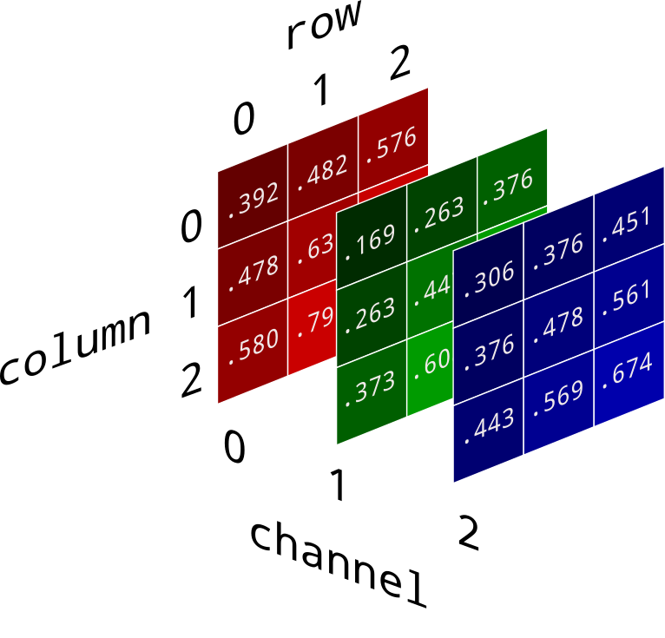
Image File Format: 3 entries of 2D Arrays
Red Green Blue
Channel 0 1 2

Slide 21
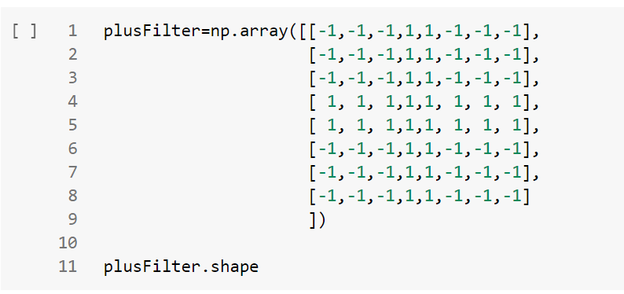
MANUAL CREATION OF A “+” FILTER (KERNEL) of size 8x8

Slide 22
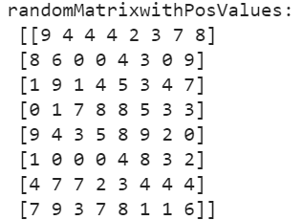
MANUAL CREATION OF A “+” FILTER (KERNEL) of size 8x8
What would be the result if you multiply plusFilter matrix with a matrix of all positive values?
*
= ?

Slide 23
MANUAL CREATION OF A “+” FILTER (KERNEL) of size 8x8
*
<=0
<=0
>=0
<=0
<=0

Slide 24
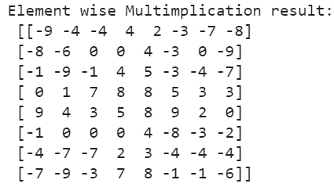
MANUAL CREATION OF A “+” FILTER (KERNEL) of size 8x8
*
<=0
<=0
<=0
<=0
>=0
>=0
<=0
<=0
<=0
<=0

Slide 25
After Multiplication, if you sum up all numbers in the resulting matrix?
<=0
<=0
<=0
<=0
>=0
>=0
<=0
<=0
<=0
<=0
3 Possibilities for the summation:
0
Negative
Positive

Slide 26
After Multiplication, if you sum up all numbers in the resulting matrix?
<=0
<=0
<=0
<=0
>=0
>=0
<=0
<=0
<=0
<=0
3 Possibilities for the summation:
0
Negative
Positive
What would they indicate you about the presence of the filter in the given image?

Slide 27
CONVOLUTION

Slide 28
CONVOLUTION
Element-wise Matrix Multiplication & Summation
<=0
<=0
*
=
>=0
<=0
<=0
SUM
<=0
<=0
>=0
<=0
<=0
-25

Slide 29
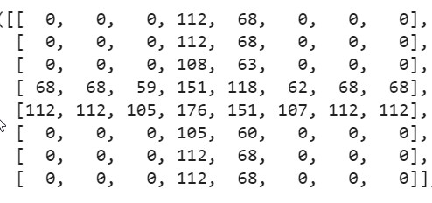
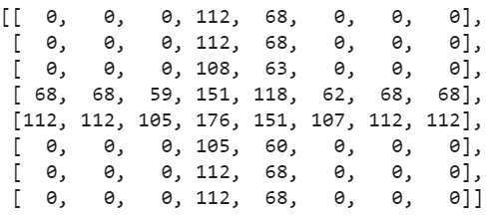
CONVOLUTION
Element-wise Matrix Multiplication & Summation
<=0
<=0
=
*
>=0
<=0
<=0
SUM
<=0
<=0
>=0
<=0
<=0
2705

Slide 30
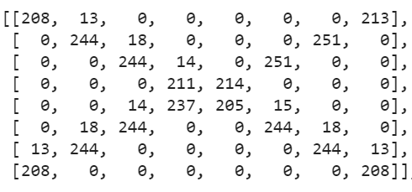
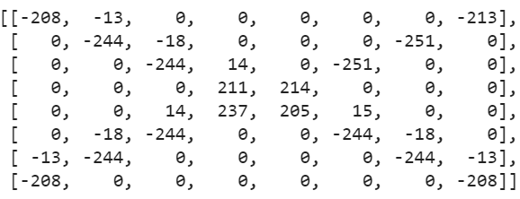
CONVOLUTION
Element-wise Matrix Multiplication & Summation
<=0
<=0
=
*
>=0
<=0
<=0
SUM
<=0
<=0
>=0
<=0
<=0
-1986

Slide 31
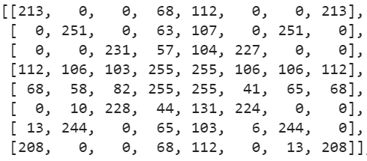
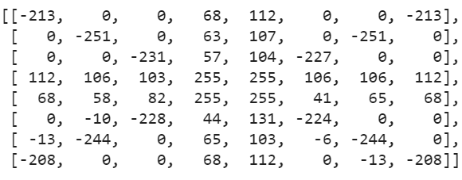
CONVOLUTION
Element-wise Matrix Multiplication & Summation
<=0
<=0
=
*
>=0
<=0
<=0
SUM
<=0
<=0
>=0
<=0
<=0
297

Slide 32
PART B: CONVOLUTION with Image of a larger size than the Filter

Slide 33
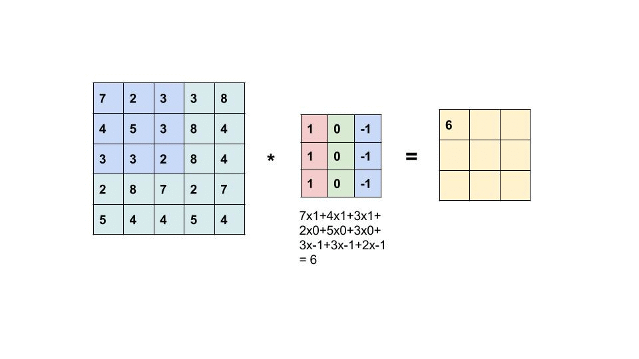
Convolution with Image of a larger size than the Filter : Stride & Padding
Image Matrix= 5x5
Filter (Kernel) = 3x3
Feature Map = 3x3

Slide 34
PART C: Keras Conv2D layer

Slide 35
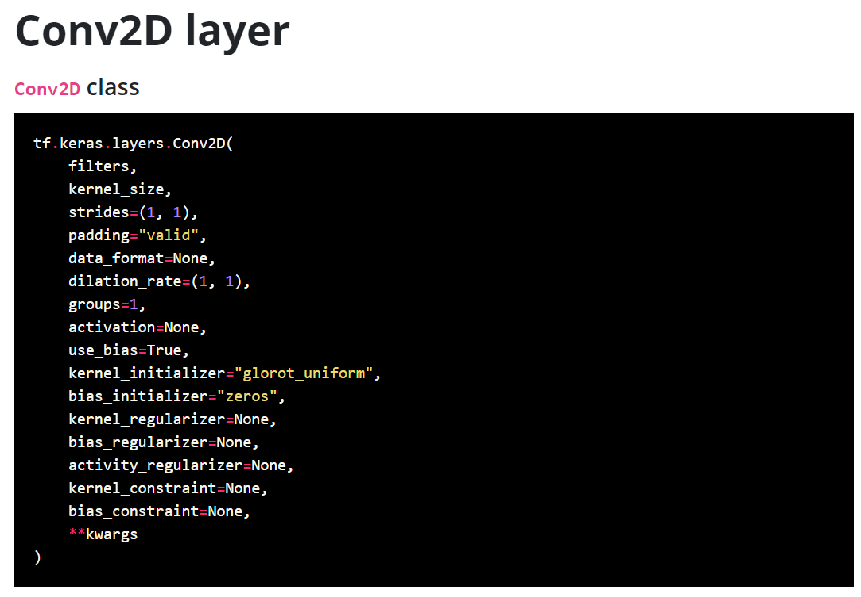

Slide 37
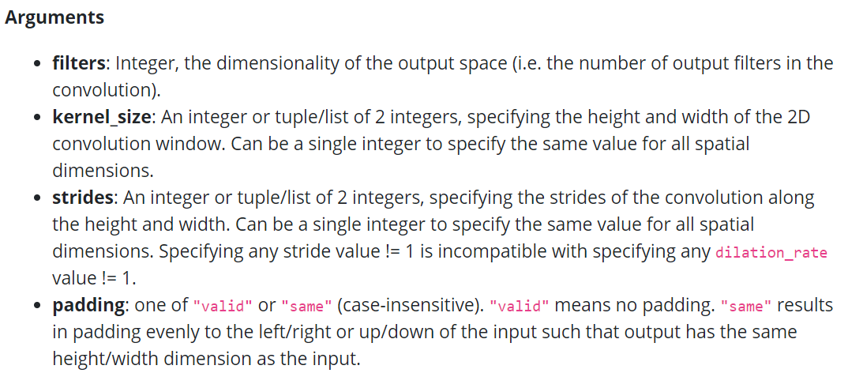

Slide 38
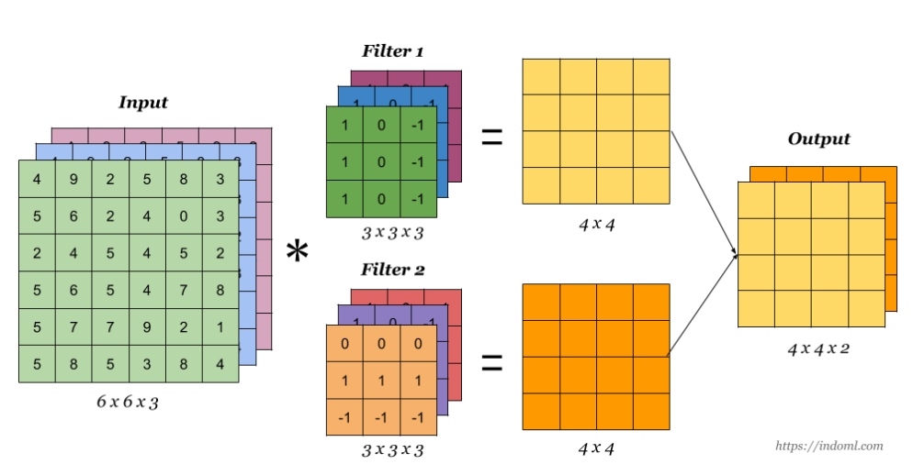

Slide 39
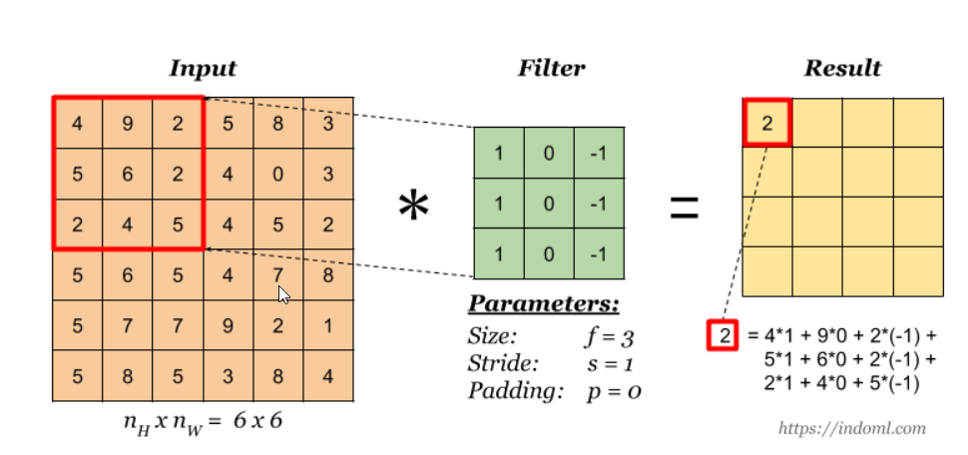

Slide 40
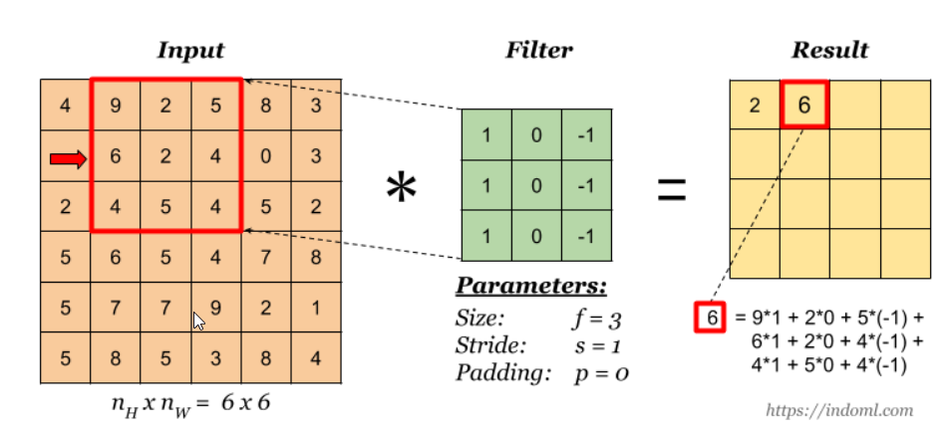

Slide 41
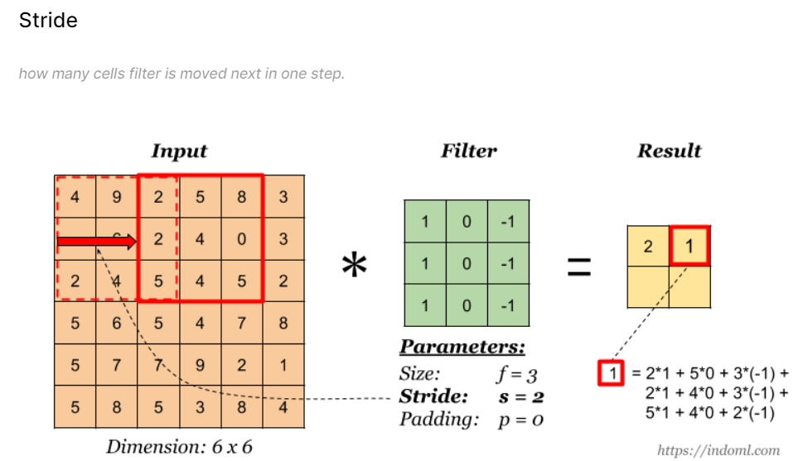
2, 2

Slide 42
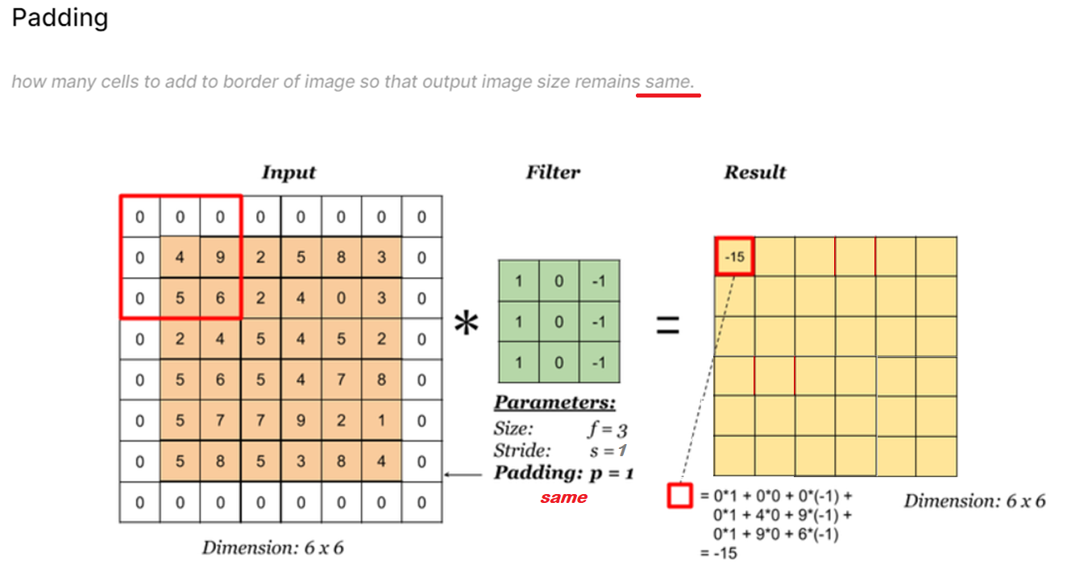
“same”

Slide 43
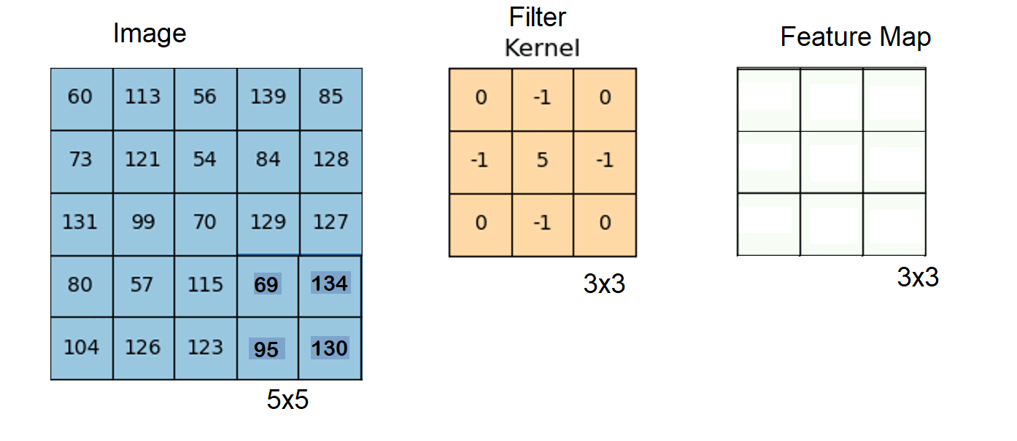
Strides=1
Image Matrix > Feature Map
padding = ‘valid’

Slide 44
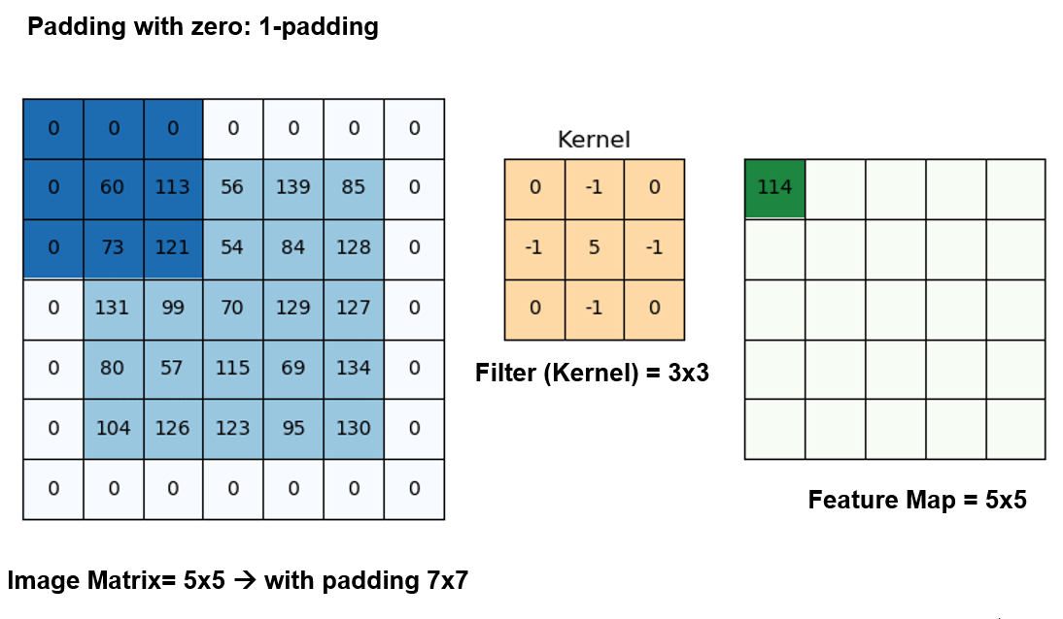
Strides=1
Image Matrix = Feature Map
padding = ‘same’

Slide 45
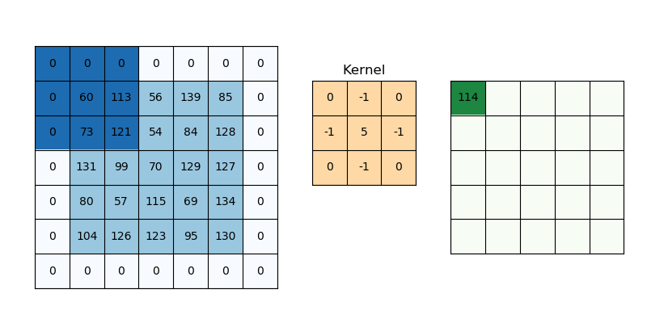
Padding with zero: 1-padding
Filter (Kernel) = 3x3
Feature Map = 5x5
Image Matrix= 5x5 → with padding 7x7

Slide 46
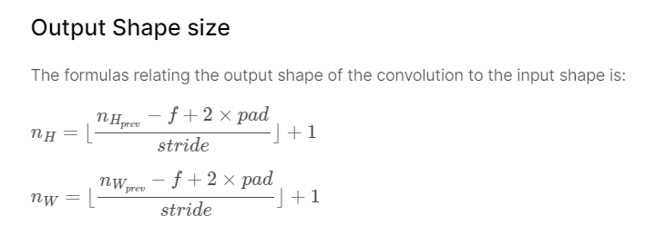

Slide 47

Another Convolution: Pooling

